Slide 1






Click on a Button! ☺

Slide 2

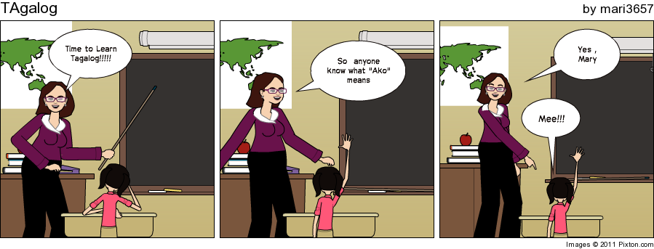
Tagalog is the Language of the Philippines. This Presentation will help you learn simple
Tagalog words and phrases.
Ako

Slide 3

Tagalog Word | English Translation
Oo | Yes
Hindi | No
Ako | Me
Ikaw | You
Bakit | Why
Ano | What
Sino | Who
Saan | Where
Gusto | Want
Wala | None
Meron | There is
When saying anything to someone older or when trying to give respect, you add “Po” to anywhere in the sentence. For example, when you say yes, you would say Opo and when you say no it’s Hindi Po.

Slide 4

Tagalog Phrase | English Equivalent
Kumusta Ka? | How are you?
Anong pangalan mo? | What’s your name?
Nasaan ______? | Where is ____?
Alam mo ba? | Do you know?
Anong gusto mo? | What do you want?
Hindi ko alam | I don’t know
These are just a few simple ones. You can still put the other words together to make sentences.

Slide 5

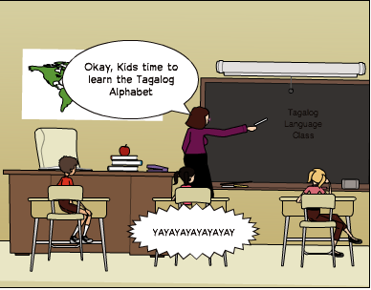
It is syllabic which means every consonant has a vowel along with it.
The Tagalog alphabet does not includee C, F, J, Q, V, X, and, Z. However, it includes the letter Ng.
The alphabet is A, Ba, Ka, Da , Ga, Ha, La , Ma, Na, Nga, Pa, Sa, Ta, Wa, Ya,E, I, Be, Bi, Ke, Ki, De, Di, Ge, Gi, He, Hi, Le, Li, Me, Mi, Ne, Ni, Nge, Ngi, Pe, Pi, Se, Si, Te, Ti, We, Wi, Ye, Yi, O, U, Bo, Bu, Ko, Ku, Do Du, Go, Gu, Ho, Hu, Lo, Lu, Mo, Mu, No, Nu, Ngo, Ngu, Po, Pu, So, Su, To, Tu, Wo, Wu, Yo, Yo.
Did you Know?: In the ancient Filipino writing system of Baybayin E and I shared one character and so did O and U.

Slide 6

Flaming Text. N.p., n.d. Web. 20 Nov. 2011. http://www4.flamingtext.com/
Cool text. N.p., n.d. Web. 20 Nov. 2011. http://cooltext.com/
Pixton. N.p., n.d. Web. 20 Nov. 2011. http://www.pixton.com/
*Informational resources on Resource page of Website
Thanks For Watching ☺

